Slide 1
DAT 500S Module 6
Quiz:
Exercise 6.8 Q2 & Q3
Group Assignment:
Exercise 6.8 Q9(parts a, b, c, d)
Individual Assignment:
Exercise 6.8 Q8(parts e, f)

Slide 2
Module 6 - Ridge Regression
Ordinary Least Squares (OLS) estimates by minimizing
Ridge Regression uses a slightly different function

Slide 3
Module 6 - LASSO
Ridge Regression minimizes
The LASSO estimates the by minimizing the

Slide 4
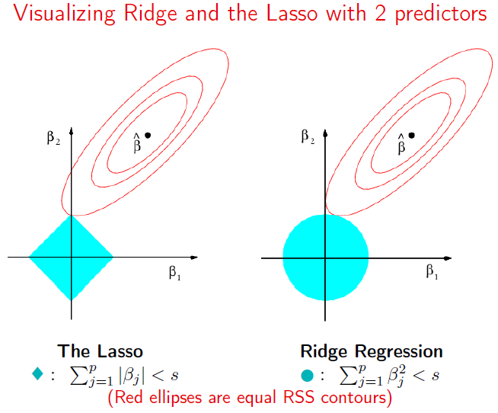
Module 6 - LASSO vs. Ridge

Slide 5
Quiz: Exercise 6.8 Q2
(a) The lasso, relative to least squares, is:
More flexible and hence will give improved prediction accuracy when its increase in bias is less than its decrease in variance.
More flexible and hence will give improved prediction accuracy when its increase in variance is less than its decrease in bias.
Less flexible and hence will give improved prediction accuracy when its increase in bias is less than its decrease in variance.
Less flexible and hence will give improved prediction accuracy when its increase in variance is less than its decrease in bias.
iii is correct. Lasso tends restrict the size and the number of regression coefficient estimates so it’s less flexible than least squares, with increased bias & decreased variance.

Slide 6
Quiz: Exercise 6.8 Q2
(b) The ridge, relative to least squares, is:
More flexible and hence will give improved prediction accuracy when its increase in bias is less than its decrease in variance.
More flexible and hence will give improved prediction accuracy when its increase in variance is less than its decrease in bias.
Less flexible and hence will give improved prediction accuracy when its increase in bias is less than its decrease in variance.
Less flexible and hence will give improved prediction accuracy when its increase in variance is less than its decrease in bias.
iii is correct. Ridge tends to restrict regression coefficients & less flexible than least squares, with increased bias & decreased variance.

Slide 7
Quiz: Exercise 6.8 Q2
(c) Non-linear methods, relative to least squares, are:
More flexible and hence will give improved prediction accuracy when its increase in bias is less than its decrease in variance.
More flexible and hence will give improved prediction accuracy when its increase in variance is less than its decrease in bias.
Less flexible and hence will give improved prediction accuracy when its increase in bias is less than its decrease in variance.
Less flexible and hence will give improved prediction accuracy when its increase in variance is less than its decrease in bias.
ii is correct. Non-linear methods are more flexible than least squares, with increased variance & decreased bias.

Slide 8
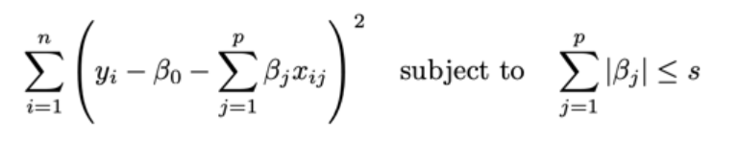
Quiz: Exercise 6.8 Q3
=> Lasso
(a) As we increase s from 0, the training RSS will:
i. Increase initially then eventually start decreasing in an inverted U shape.
ii. Decrease initially then eventually start increasing in a U shape.
iii. Steadily increase.
iv. Steadily decrease.
v. Remain constant.
iv. Is correct.
Increase s -> relax restriction -> # coefficient increased -> more flexible -> lower training RSS
Notes:
When the number of features p is large, there tends to be a deterioration in the performance of KNN and other local approaches that perform prediction using only observations that are near the test observation for which a prediction must be made. This phenomenon is known as the curse of dimensionality, and it ties into the fact that non-parametric approaches often perform poorly when p is large. We will now investigate this curse.

Slide 9
Quiz: Exercise 6.8 Q3
=> Lasso
(b) As we increase s from 0, the testing RSS will:
i. Increase initially then eventually start decreasing in an inverted U shape.
ii. Decrease initially then eventually start increasing in a U shape.
iii. Steadily increase.
iv. Steadily decrease.
v. Remain constant.
ii. Is correct. As more coefficients are not restricted to be 0, the model will become more flexible; testing RSS will firstly decrease as bias is decreased more than variance is increased but will increase then as the model starts overfitting.
Notes:
When the number of features p is large, there tends to be a deterioration in the performance of KNN and other local approaches that perform prediction using only observations that are near the test observation for which a prediction must be made. This phenomenon is known as the curse of dimensionality, and it ties into the fact that non-parametric approaches often perform poorly when p is large. We will now investigate this curse.

Slide 10
Quiz: Exercise 6.8 Q3
=> Lasso
(c) As we increase s from 0, the variance will:
i. Increase initially then eventually start decreasing in an inverted U shape.
ii. Decrease initially then eventually start increasing in a U shape.
iii. Steadily increase.
iv. Steadily decrease.
v. Remain constant.
iii. Is correct.
More estimated coefficients -> more flexible model -> increased variance
Notes:
When the number of features p is large, there tends to be a deterioration in the performance of KNN and other local approaches that perform prediction using only observations that are near the test observation for which a prediction must be made. This phenomenon is known as the curse of dimensionality, and it ties into the fact that non-parametric approaches often perform poorly when p is large. We will now investigate this curse.

Slide 11
Quiz: Exercise 6.8 Q3
=> Lasso
(d) As we increase s from 0, the bias will:
i. Increase initially then eventually start decreasing in an inverted U shape.
ii. Decrease initially then eventually start increasing in a U shape.
iii. Steadily increase.
iv. Steadily decrease.
v. Remain constant.
iv. Is correct.
More estimated coefficients -> more flexible model -> decreased bias
Notes:
When the number of features p is large, there tends to be a deterioration in the performance of KNN and other local approaches that perform prediction using only observations that are near the test observation for which a prediction must be made. This phenomenon is known as the curse of dimensionality, and it ties into the fact that non-parametric approaches often perform poorly when p is large. We will now investigate this curse.

Slide 12
Quiz: Exercise 6.8 Q3
=> Lasso
(e) As we increase s from 0, the irreducible error will:
i. Increase initially then eventually start decreasing in an inverted U shape.
ii. Decrease initially then eventually start increasing in a U shape.
iii. Steadily increase.
iv. Steadily decrease.
v. Remain constant.
v. Is correct.
irreducible error depends only on data itself and will not change with model flexibility.
Notes:
When the number of features p is large, there tends to be a deterioration in the performance of KNN and other local approaches that perform prediction using only observations that are near the test observation for which a prediction must be made. This phenomenon is known as the curse of dimensionality, and it ties into the fact that non-parametric approaches often perform poorly when p is large. We will now investigate this curse.

Slide 13
Group Assignment: Exercise 6.8 Q 9
library(ISLR)
attach(College)
View(College)
any(is.na(College))
dim(College)
(a) Split the data set into a training set and a test set.
Set random seed
⇒ set.seed(100)
Split train & test
⇒ train = sample(nrow(College),nrow(College)/2,replace = FALSE)

Slide 14
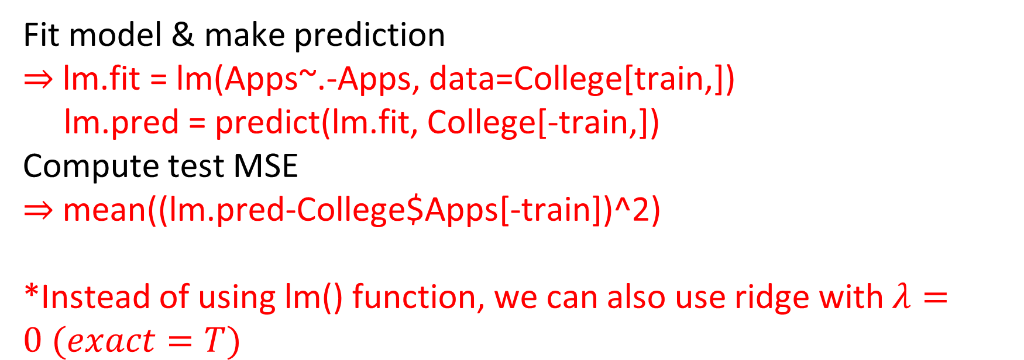
Group Assignment: Exercise 6.8 Q 9
(b) Fit a linear model using least squares on the training set, and report the test error obtained.
Fit model & make prediction
⇒ lm.fit = lm(Apps~.-Apps, data=College[train,])
lm.pred = predict(lm.fit, College[-train,])
Compute test MSE
⇒ mean((lm.pred-College$Apps[-train])^2)
*Instead of using lm() function, we can also use ridge with $λ=0 (exact=T)$

Slide 15
Group Assignment: Exercise 6.8 Q 9
(c) Fit a ridge regression model on the training set, with λ chosen by cross-validation. Report the test error obtained.
library (glmnet)
Create x matrix & y vector
⇒ x=model.matrix(Apps~.,College)[,-1]
y=College$Apps
Train model
⇒ grid=10^seq(10,-2, length =100)
ridge.mod=glmnet(x[train,],y[train],alpha=0,lambda=grid, thresh=1e-12)
[,-1]: excludes intercept
Model.matrix() function automatically creates a first column of intercept (vector of 1)

Slide 16
Group Assignment: Exercise 6.8 Q 9
(c) Fit a ridge regression model on the training set, with λ chosen by cross-validation. Report the test error obtained.
Use cross-validation to choose λ
⇒ set.seed(1)
cv.out=cv.glmnet(x[train,],y[train],alpha=0)
plot(cv.out)
bestlam =cv.out$lambda.min
Make prediction
⇒ ridge.pred=predict(ridge.mod,s=bestlam,
x=x[train,],y=y[train],newx=x[-train,],exact=T)
Compute test MSE
⇒ mean((ridge.pred - y[-train])^2)

Slide 17
Group Assignment: Exercise 6.8 Q 9
(d) Fit a lasso model on the training set, with λ chosen by cross-validation. Report the test error obtained, along with the number of non-zero coefficient estimates.
Train model (same as ridge, with the only change being alpha=1)
⇒ lasso.mod=glmnet(x[train,],y[train],alpha=1,lambda=grid, thresh=1e-12)
Use cross-validation to choose λ
⇒ set.seed(1)
cv.out=cv.glmnet(x[train,],y[train],alpha=1)
plot(cv.out)
bestlam =cv.out$lambda.min

Slide 18
Group Assignment: Exercise 6.8 Q 9
(d) Fit a lasso model on the training set, with λ chosen by cross-validation. Report the test error obtained, along with the number of non-zero coefficient estimates.
Make prediction
⇒ lasso.pred=predict(lasso.mod, s=bestlam,
x=x[train,],y=y[train],newx=x[-train,],exact=T)
Compute test MSE
⇒ mean((lasso.pred - y[-train])^2)

Slide 19
Group Assignment: Exercise 6.8 Q 9
(d) Fit a lasso model on the training set, with λ chosen by cross-validation. Report the test error obtained, along with the number of non-zero coefficient estimates.
Get coefficients
⇒ lasso.coef=predict(lasso.fit,type="coefficients",s=bestlam)[-1,]
Non-zero coefficients
⇒ lasso.coef[lasso.coef!=0]
length(lasso.coef[lasso.coef!=0])
Use “ type=‘coefficients’ ” to get estimated coefficients
[-1,]: exclude intercept

